Slide 1

Machine Learning 101
It's an exciting time for ML. There is ample work to be done at all levels: from the theory end to the framework end, much can be improved. It's almost as exciting as the creation of the internet.
- Ryan Dahl, author of Node.js
Catherine Zeng, Dell EMC Intern Advanced Server Engineering
Studying EECS, Massachusetts Institute of Technology ‘20
Notes:
Transcript:
Machine learning is a hot topic right now. You can see it in the media… everything from Kristen Stewart co- authoring a paper on Artificial intelligence, to Mark Zuckerberg and Elon Musk arguing about the dangers of artificial intelligence in the future.
With increased computational capacities and big data, companies like Facebook and Google have been able to make many groundbreaking advancements in machine learning, and their research centers like Google brain have made enormous amounts of revenue for its parent company Alphabet as a result.
To quote Ryan Dahl, the author of Node.js: “It's an exciting time for ML. There is ample work to be done at all levels: from the theory end to the framework end, much can be improved. It's almost as exciting as the creation of the internet.”

Slide 2
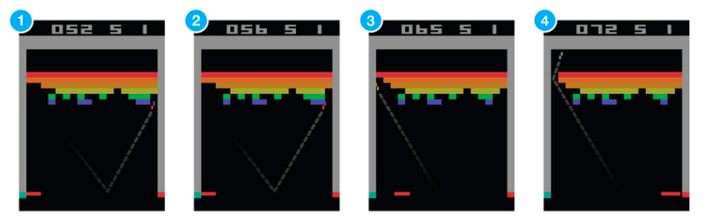
What is Machine Learning?
Machine learning creates models that are built automatically using algorithms that iteratively learn from data, so that the machine can find patterns in data without the need for us to define them.
Notes:
Pictures to apply to next slide
Transcript: So what is Machine Learning?
Machine Learning is a subset of Artificial Intelligence in which the computer iteratively learns from data so that the machine can find patterns without humans needing to explicitly define them.

Slide 3
Where have you seen Machine Learning?
Recommender problems: Amazon or Netflix analyzing your activity and comparing it to other users with similar activity to make recommendations.
Game Playing: Using deep neural networks and tree search, AlphaGo is a Machine Learning powered computer program that beat the world’s No.1 ranked player Ke Jie.
Self-Driving Cars: Google, Apple, and Tesla, among most other car manufacturers, are developing autonomous vehicles that are trained using computer vision.
Computer-aided detection (CADe) and diagnosis (CAD): Support vector machines (SVMs), linear discriminant analysis, and deep neural networks, among other algorithms, are being used in medical imaging to diagnosis.
QUESTION: Can you think of Machine Learning in your life? (Type response)
Notes:
Make the bullets into nice graphs separating them
Transcript:
You’ve most likely seen Machine Learning in all sorts of applications in your life. Your iphone uses natural language processing to power Siri, and Netflix uses recommender algorithms to provide you with movie suggestions. Recently AlphaGo defeated the world’s no.1 ranked player Ke Jie in the complex game Go, and self-driving cars are currently being developed by almost every single car manufacturer.
Can you think of Machine Learning applications in your own life?

Slide 4
Stages of Machine Learning Implementation:
1) Determining objectives and metric: what is the purpose of this model? How will the quality of the model be assessed?
2) Preparing the dataset:
Select the data relevant to the question or problem and evaluate the quality of the dataset.
Preprocess the data, which includes formatting, cleaning data to fill in missing values, or taking a smaller sample of the data.
Transform data using knowledge of the algorithm you are working with and problem domain. This includes scaling data, splitting data, or aggregating data.
3) Model training: Select a machine learning algorithm to apply to the data, with will learn patterns and output a model that matches these relationships.
4) Integration and testing: Evaluate the quality of the model on test data, and continue monitoring the quality of the model on new testing data.
QUESTION: What is of the following is NOT considered steps to preprocess data? A) Taking a smaller sample of the data, B) Formatting the data, C) Making up data for a larger sample size, or D) Cleaning data to fill in missing values.
ANSWER: C) Making up data for a larger sample size. From the excerpt: “Preprocess the data, which includes formatting, cleaning data to fill in missing values, or taking a smaller sample of the data.”
Notes:
Make the bullets into nice graphs separating them.
Transcript:
Machine Learning happens through many stages.
First, you must determine the objectives and metrics. What problem are you solving with this model? How will the quality of this model be assessed?
Second, you must prepare the dataset, which involves picking a quality dataset, preprocessing the data, and transforming it to fit the problem domain.
After that, you must train the model, which includes selecting, or inventing an effective machine learning algorithm to be applied to the data.
Finally you must evaluate the quality of the model on test data that it has never seen before, and monitor the model’s ability to evaluate new data in the real world.

Slide 5
Key Terms
Training set: dataset used to find relationships between data
Testing set: Data used to evaluate the quality of the trained model.
Training Error: Error when you run the trained model on the training set.
Testing Error: Error when you run the trained model on the testing set, which the model hasn’t seen yet.
QUESTION: Which do you think would be higher, A) the training error or B) the testing error?
ANSWER: The testing error would be higher because the model is applied to data it has never seen before, whereas for the training error the model is applied to the very data it was built off of!
Notes:
Make the bullets into nice graphs separating them
Transcript:
Some of the most important key terms in Machine Learning includes understanding the difference between the training set and the testing set, and the difference between the training error and the testing error.
The training set is the data used to construct the machine learning model, whereas the testing set is data the model has never seen before that can be used to evaluate the quality of the trained model.
The training error is the error you get from running the trained model on the training set, whereas the testing error is the error you get from running the trained model on the testing set. Usually the testing error is much higher than the training error, especially when the model overfits so that it so perfectly represents the training set that it is unable to generalize to other data.

Slide 6
Machine Learning algorithms:
Supervised Learning:
The system is given a training set that is labeled, and asked to label a testing set. Examples: Linear classifiers, Perceptron algorithm, Support Vector Machines, Neural Networks, Naïve Bayes. Supervised learning often involves classification and regression. Classification separates data into distinct classes and include SVMs and decision trees.
Unsupervised Learning:
The system is given unlabeled data and asked to classify the data. Examples: Gaussian Mixture Models, K-Means algorithm. Unsupervised learning often includes clustering, which groups data together and finds similarities between them.
Reinforcement Learning:
The system learns actions to maximize rewards in a reward system. Examples include Q-learning which can be used to find optimal policies for Markov decision processes. Reinforcement learning is used to teach computers to play video games. The most famous is Google DeepMind’s deep reinforcement learning model playing Atari.
QUESTION: Which if the following is not considered supervised learning? You can select more than one. A) Support Vector Machines, B) Gaussian Mixture Models, C) the Perceptron Algorithm, D) Q-Learning.
ANSWER: B) Gaussian Mixture Models, and D) Q-Learning. Gaussian Mixture Models is unsupervised learning, and Q-Learning is reinforcement learning.
Notes:
Make the bullets into nice graphs separating them
Transcript:
Machine Learning is organized into three sets: supervised learning, unsupervised learning, and reinforcement learning.
In supervised learning, the system is given a training set that has already been labeled. Examples of algorithms that fall into this category are linear classifiers, the perceptron algorithm, and support vector machines.
In unsupervised learning, the system is given a training set that has NOT already been labeled, and classifies the data, usually through clustering. Examples of algorithms include Gaussian Mixture Models, and the K-Means algorithm.
In Reinforcement learning, the system is given a utility function and it tries to maximize rewards in a clearly defined rewards system. The most famous example of reinforcement learning is Google DeepMind’s deep reinforcement learning model playing Atari.

Slide 7
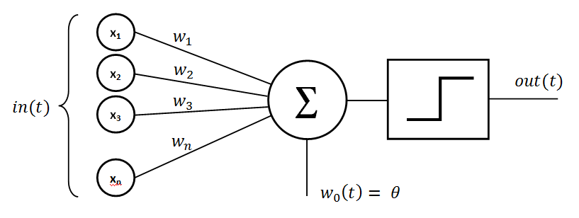
Overview of ML Algorithms and Important Concepts
Perceptron – The perceptron is the most basic machine learning algorithm that learns a linear classifier to separate two groups of data.
Notes:
Transcript:
The perceptron is the most basic machine learning algorithm. It is a linear classifier that separates data into two groups, and it is the foundation of artificial neural networks. It is often the first algorithm taught in academic settings.

Slide 8
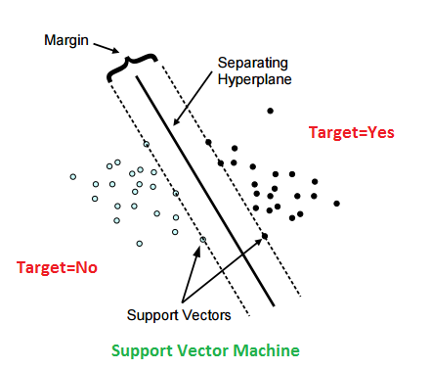
Overview of ML Algorithms and Important Concepts
Support Vector Machine (SVM) – A linear classifier that separates two groups of data through a separating hyperplane.
Notes:
Transcript:
The Support Vector Machine is another linear classifier that separates two groups of data through a separating hyperplane. The margin is the maximum distance of the hyperplane that can be draw to separate the two groups of data.

Slide 9
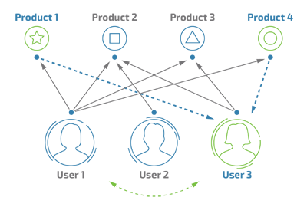
Overview of ML Algorithms and Important Concepts
Collaborative filtering and Recommender systems: Makes predictions or recommendations about a user based on other users in the system.
Notes:
Collaborative filtering and recommender systems are what powers Netflix and Amazon. These algorithms make recommendations about a user based on what other users similar to the original user prefers in the system.

Slide 10

Overview of ML Algorithms and Important Concepts
Kernels: Makes nonlinear data compatible with linear models by mapping data to higher dimensions that show linear patterns.
Notes:
Transcript:
Kernels transform data that weren’t otherwise linear by mapping them to higher dimensions that enable the data to show linear patterns.

Slide 11

Overview of ML Algorithms and Important Concepts
Neural Networks: Made up of layers of interconnected nodes that contain an activation function. Modeled after our understanding of biological neurons. Popular neural networks include recurrent neural networks and convolutional neural networks.
Notes:
Neural Networks are modeled after our understanding of biological neurons, and are constructed from the basic perceptron model. Neural Networks are made up of layers of interconnected nodes that contain an activation function. The most popular neural networks include recurrent neural networks, also known as RNNs, and convolutional neural networks, also known as CNNs. Neural Networks are the most popular machine learning algorithm featured in the news, and other breakthroughs.

Slide 12
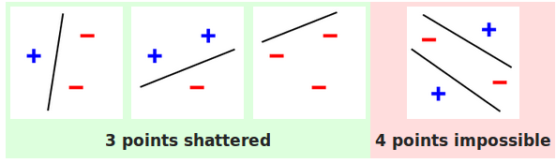
Overview of ML Algorithms and Important Concepts
Vapnik–Chervonenkis theory (VC Dimension): a measure of the capacity of a classifier, which includes complexity, expressive power, richness, or flexibility.
Notes:
Transcript:
VC Dimension is a way of evaluating a classifier through complexity, expressive power, richness, or flexibility.
In the example image above, you can see that a single line can separate all variations of how three points are labeled, but cannot necessarily separate all variations of how four points are labeled.

Slide 13
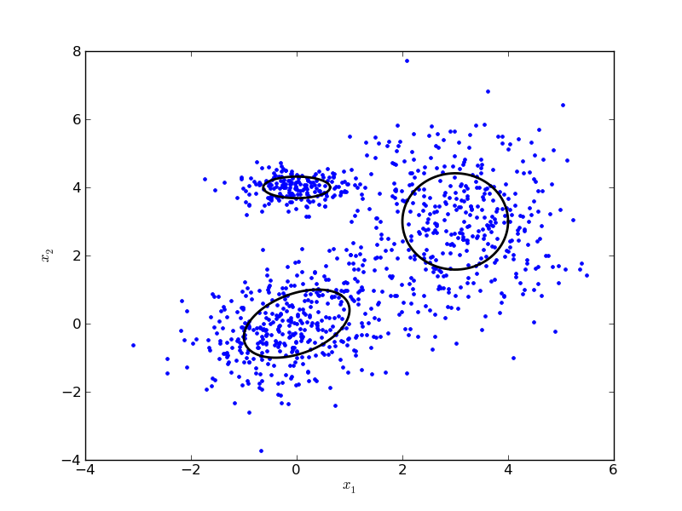
Overview of ML Algorithms and Important Concepts
Gaussian Mixture Models: probabilistic models to represent normally distributed clustering of data; a type of unsupervised learning.
Notes:
The Gaussian Mixture Model is a probabilistic model designed to cluster data, and is a form of unsupervised learning. The model is able to figure out parameters through seeing which data can be grouped together.

Slide 14
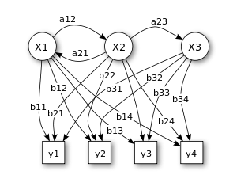
Overview of ML Algorithms and Important Concepts
Hidden Markov Models (HMMs): HMMs are a set of states that are each associated with a probability distribution.
Notes:
Transcript:
The Hidden Markov Model is the simplistic dynamic Bayesian network. It is a statistical model that contains a set of states, each associated with a probabilistic distribution.

Slide 15
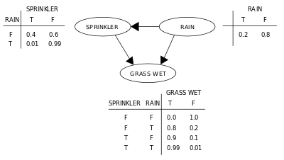
Overview of ML Algorithms and Important Concepts
Bayesian network: a probabilistic model that represents random variables and their conditional dependencies.
Notes:
Transcript:
The Bayesian network is a probabilistic model that represents random variables and their conditional dependencies. It is the marriage between probability theory and graph theory.

Slide 16
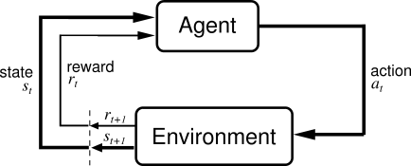
Overview of ML Algorithms and Important Concepts
Reinforcement learning: how to take actions in an environment to maximize reward with respect to a predetermined goal.
QUESTION: What is your favorite machine learning algorithm?
Notes:
Transcript:
Reinforcement learning teaches an agent how to take action in an environment to maximize reward with respect to a predetermined goal. Whenever you see YouTube videos of computers learning to play videos games such as Atari and Super Mario brothers, the computers likely have been trained using reinforcement learning.

Slide 17
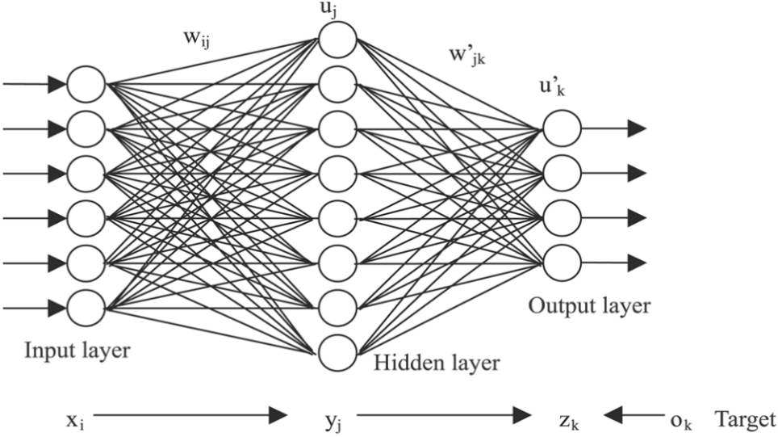
Artificial Neural Networks (ANNs)
ANNs are based on our understanding of biological neural networks, and is based on the basic perceptron. ANNs contain an input layer, a hidden layer, and an output layer. It is made of interconnected nodes with weights and an activation functions that describe the strength of the connection.
For more information, read this.
Notes:
Transcript:
Artificial Neural Networks are all the rage nowadays, and it is worthwhile to go more in depth with their variants. Artificial Networks contain an input layer, a hidden layer, and an output layer. They are made of interconnected nodes with weights and an activation function that describes the strength of the connection.

Slide 18
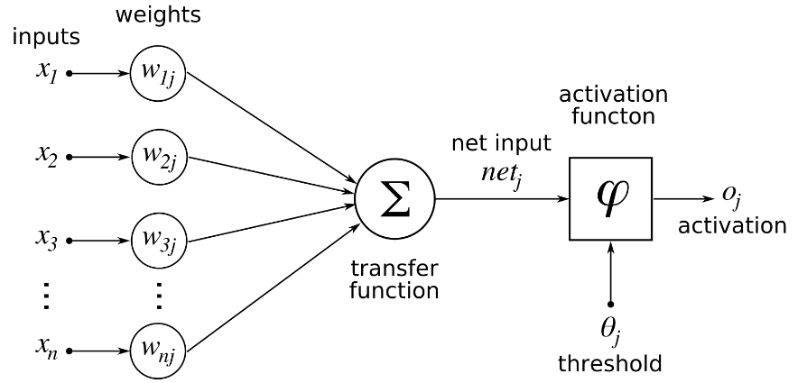
Artificial Neural Networks (ANNs)
QUESTION: What is the basic linear classified that artificial neural networks are based off of? A) Bayes Tree, B) Naïve Bayes, C) Support Vector Machines, D) the Perceptron
ANSWER: D) the Perceptron
Notes:
The image should go with the previous slide

Slide 19
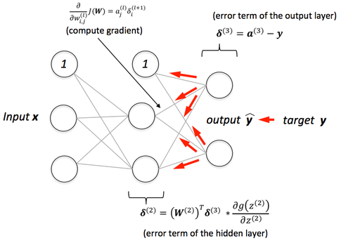
Artificial Neural Networks (ANNs)
Backpropagation is used in ANNs to calculate the gradient of the loss function with respect to weights. Backpropagation better adjusts weights in a neural network model so that it has better performance.
Notes:
Transcript:
Backpropagation is used in artificial neural networks to calculate the gradient of the loss function with respect to weights. Basically backpropagation helps artificial neural networks achieve better performance.

Slide 20
Artificial Neural Networks (ANNs)
The feedforward neural network is the simplest class of artificial neural networks. Information in the feedforward neural network only moves in the forward direction. Other classes of artificial neural networks include the recurrent neural network and convolutional neural network.
Notes:
Transcript:
The feedforward neural network is the simplest class of artificial neural networks. Information in the feedforward neural network only moves in the forward direction. Other classes of artificial neural networks include the recurrent neural network and convolutional neural network.

Slide 21
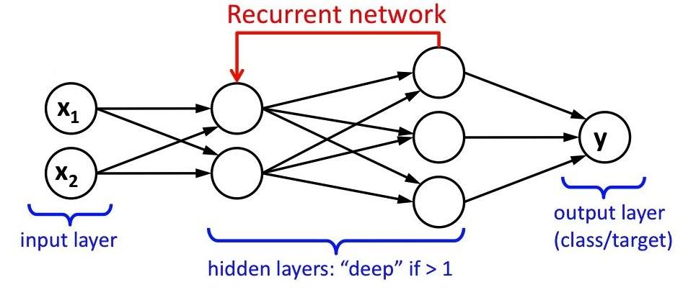
Artificial Neural Networks (ANNs)
Recurrent Neural Network (RNN): Unlike the feedforward neural network, information moves in a cycle in the recurrent neural network. This means that the RNN depends on the output of the previous step, which is analogous of a “memory” that stores previous outputs. RNNs are arguably the most powerful type of neural network and is commonly used in natural language processing tasks.
Notes:
Transcript:
The Recurrent Neural Network, also known as RNNs, are different from the feedforward neural network because the RNN’s information depends on the output of the previous step. You can think of this as analogous to “memory” that stores previous outputs. RNNs are arguably the most powerful type of neural network, and it is commonly used in natural language processing tasks.

Slide 22
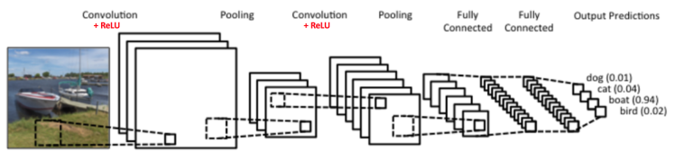
Artificial Neural Networks (ANNs)
Convolutional Neural Network (CNN or ConvNet): CNNs are primarily used for visual imagery and is common in computer vision tasks. CNNs are designed to deal with 2D input structures and consists of three types of layers: the convolutional layer, pooling layer, and fully-connected layer. In 2015, a CNN was able to beat a human in object recognition for the first time.
Notes:
Transcript:
Convolutional Neural Networks, also known as CNNs, or Convnets, are primarily used in computer vision where they are good at identifying objects and faces. CNNs are often used in robot sensing and self driving cars.

Slide 23
Artificial Neural Networks (ANNs)
Artificial neural networks that contain more than one hidden layer are considered to be deep learning. Deep learning is part of the learning data representations method of machine learning, which is based on feature detection, and can range anywhere from supervised to unsupervised learning. Because deep learning is so computationally expensive, they have popularized the usage of graphics processing units (GPUs) because of their higher memory bandwidth.
QUESTION: How many layers does deep learning have? A) 1, B) 2, C) 3 D) 4
ANSWER: Trick question! Deep learning is considered to be artificial neural networks with more than one hidden layer in addition to the input and output layer. So Deep Learning is considered to be ANNs with more than three layers.
Notes:
Transcript:
Deep learning is considered to be artificial neural networks that contain more than one hidden layer, and can consist of RNNs, CNNs, feedforward neural networks, or some combination of them all. Because deep learning is so computationally expensive, it has become very common to use graphics processing units, or GPUs, to train the models and then run the models on real life data.

Slide 24
Artificial Neural Networks (ANNs)
QUESTION: Which of the following algorithms is used primarily in computer vision? A) Convolutional Neural Networks, B) Backpropagation, C) Recurrent Neural Networks, D) GPUs
ANSWER: A) Convolutional Neural Networks. ConvNets are primarily used for visual imagery and is common in computer vision tasks.
QUESTION: Why are GPUs faster than CPUs? A) They are more expensive, B) They contain deep learning inspired hardware, C) They consume more power than GPUs do, D) They have a higher memory bandwidth
ANSWER: D) They have a higher memory bandwidth. The next section will explain this more in detail.

Slide 25
GPUs and Nvidia
Memory bandwidth is the rate at which data can be read from or store into a semiconductor memory by a processor. GPUs have much higher memory bandwidths than CPUs do, making GPUs better at doing matrix multiplication and convolution common in deep learning. GPUs can have up to 750 GB/s memory bandwidth while CPUs can only have up to 50 GB/s.
GPUs have higher latency than CPUs do, but this is masked under thread parallelism. Overall, GPUs are MUCH faster at processing large amounts of data than CPUs are. For an analogy, see here.
At the moment, Nvidia dominates the market for GPUs with models ranging from its Titan X to its Tesla P4, which are compatible for usage with Dell’s servers.
Notes:
Transcript:
GPUs are more effective at processing deep learning because of their higher memory bandwidth. This is the rate at which data can be read from or stored into a semiconductor memory by a processor.
The CPU is good at fetching small amounts of memory quickly while the GPU is good at fetching large amounts of memory. CPUs have lower latency than GPUs do, which means they can transport memory faster, but because GPUs enable thread parallelism, the lower latency is masked by the memory in its queue.
GPUs can have up to 750 GB/s memory bandwidth while CPUs can only have up to 50 GB/s. This is a big difference.
At the moment, Nvidia dominates the market for GPUs.

Slide 26
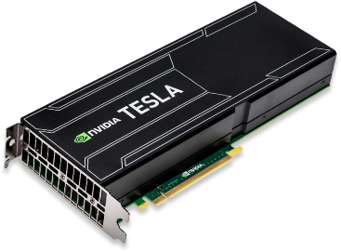
GPUs and Nvidia
QUESTION: True or False, CPUs have a better memory bandwidth than GPUs do.
ANWER: False. GPUs are able to better run machine learning tasks because it has a higher memory bandwidth.

Slide 27
Important People in Machine Learning Development
Geoffrey Hinton, professor at the University of Toronto and Engineering Fellow at Google managing the Brain Team Toronto. Hinton is the most important figure in deep learning. He demonstrated backpropagation for deep neural nets, co-invented Boltzmann machines (a type of recurrent neural network), and more.
Yann LeCun, Director of AI Research at Facebook and professor at NYU’s Courant Institute of Mathematical Sciences. LeCun is known for his work using convolutional neural networks for computer vision and is known as the founding father of CNNs.
Andrew Ng, former chief scientist at Baidu, adjunct professor at Stanford University, and co-founder of Coursera. Ng is known for his popular Machine Learning course on coursera and for popularizing machine learning concepts with the general public.
Peter Norvig, Director of Research at Google. Norvig is known for being the c-author of the leading textbook Artificial Intelligence: A Modern Approach
Michael I. Jordan is a professor at the University of California, Berkeley, and is known for popularizing Bayesian networks and for his research in the intersection of Machine Learning and statistics.
Notes:
Transcript:
It might also be worthwhile to follow the progress of some important people in machine learning development. This includes Geoffrey Hinton, who popularized deep learning, Yann LeCun, who is known as the founding father of CNNs, Andrew Ng, who popularized Machine Learning through his well known Coursera class, Peter Norvig, who is a big name in artificial intelligence, and Michael Jordan, who did a lot of work for the intersection between Machine Learning and statistics.

Slide 28
Important People in Machine Learning Development
QUESTION: Who is known as the father of deep learning? A) Yan LeCun, B) Peter Norvig, C) Michael Jordan, D) Geoffrey Hinton
ANSWER: D) Geoffrey Hinton. Hinton is well-known as the father of deep learning.

Slide 29
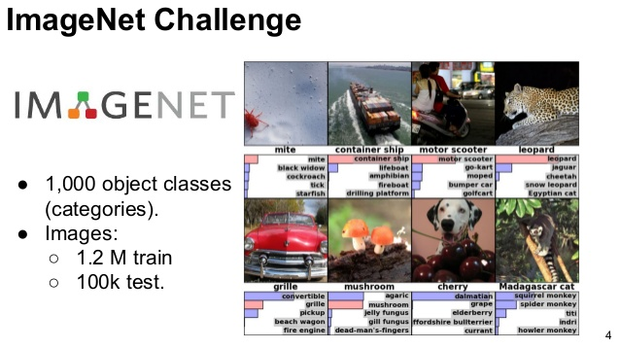
ImageNet Project and Challenge
The ImageNet project is a database of annotated images used for research in visual object recognition developed by Stanford professor Fei-Fei Li. Every year since 2010, ImageNet has ran the ImageNet Large Scale Visual Recognition Challenge (ILSVRC) for contenders to develop algorithms that most accurately do image recognition on the ImageNet dataset. The most revolutionary winners of the ImageNet challenge include AlexNet (2012) and GoogLeNet (2014).
Notes:
Transcript:
The ImageNet Project, founded by Stanford professor Fei-Fei Li, was also significant because it released the biggest dataset yet of annotated images, which enabled much progress to be made in computer vision.
Every year since 2010, ImageNet ran the ImageNet Large Scale Visual Recognition Challenge for contenders to develop algorithms that can most accurately do image recognition on the ImageNet dataset. Well known winners include AlexNet and GoogLeNet, both of which were convolutional neural networks.

Slide 30
For More Resources
Follow Andrew Ng’s popular Machine Learning course on Coursera here.
Follow Geoffrey Hinton’s Machine Learning course on Coursera here.
Synopsis of some Machine Learning papers here.
Popular YouTuber Siraj Raval explains Machine Learning concepts here.
Recently appointed Director of AI at Tesla Andrej Karpathy’s blog here.
Deep Learning by Ian Goodfellow, Yoshua Bengio, and Aaron Courville, the most updated and popular deep learning textbook here.
Notes:
Transcript:
For more resources, you can take Andrew Ng or Geoffrey Hinton’s machine learning courses for free on Coursera.
You can also follow machine learning papers, or watch YouTube videos by Siraj Raval which are entertaining and easy to follow.
Popular blogs such as Andrej Karpathy’s are also interesting, and finally you can read textbooks, which includes the most famous deep learning textbook by Goodfellow, Bengio, and Courville.
These are just some of the many resources on the web.

Slide 31
Conferences to attend:
Academic:
NIPS (Neural Information Processing Systems)
ICML (International Conference on Machine Learning)
KDD (Knowledge Discovery and Data Mining)
ICLR (International Conference on Learning Representations)
ACL (Association for Computational Linguistics)
EMNLP (Empirical Methods in Natural Language Processing)
CVPR (Computer Vision and Pattern Recognition)
ICCF (International Conference on Computer Vision)

Slide 32
Conferences to attend:
Professional:
O’Reilly Artificial Intelligence Conference
Machine Learning Conference (MLConf)
AI Expo (North America, Europe, World)
AI Summit
AI Conference

